Slide 1
Network-based analysis on Chicago Bicycle Sharing
Yuanda Zhu
12/11/2017
CS 7280 Final Project

Slide 2
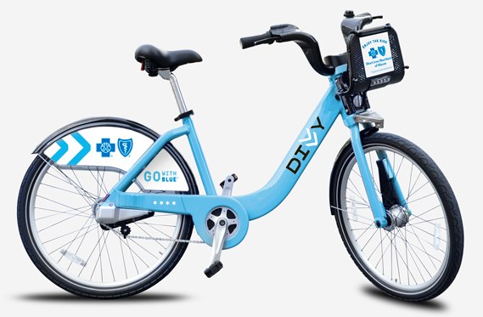
Background
Why bicycle?
Cheap and convenient within short distance
Environment-friendly
Workout when commuting
Why data from Divvy?
350 stations in July, 2013; 560 stations in June, 2017
80k-140k total rides per half year
Currently, 580 stations and 5,800 bikes
1,700 annual members
Figure 1. Divvy Bike.

Slide 3
Problem Statement
How to better manage the stations as well as the bikes?
Popular stations
Hot paths
New station
Outgoing and incoming traffic
Transferring bikes vs. larger stations
Community detection
Machine learning

Slide 4
Related Work
Unsupervised Clustering Algorithms
K-means
Spectral Clustering (OPTICS)
HDBSCAN (Hierarchical Density-Based Spatial Clustering of Applications with Noise)
Machine Learning
Decision Tree and Random Forest
Linear Regression
Neural Network
Q-learning

Slide 5
Methodology Part 1: The undirected network and HDBSCAN
Build the undirected, weighted network
Why HDBSCAN?
No a priori knowledge required on number of clusters
Can detect arbitrary shape
Can identify outliers

Slide 6
Methodology Part 2: The directed network and Q-learning
Build directed network
Morning rides (end 7-11am) and evening rides (start 4-8pm)
Three-Month per network, overlapping two months
Total of 46 morning, 46 evening networks
Truncate less frequent paths (less than 50 rides)
Pick 10 stations with highest degrees in the first half year network
In degree centrality and out degree centrality (relative popularity)
Q-learning
30 for training, 15 for testing
Prediction: rise ( >+25%), drop ( >-25%), level ( -25% ~ +25%)

Slide 7
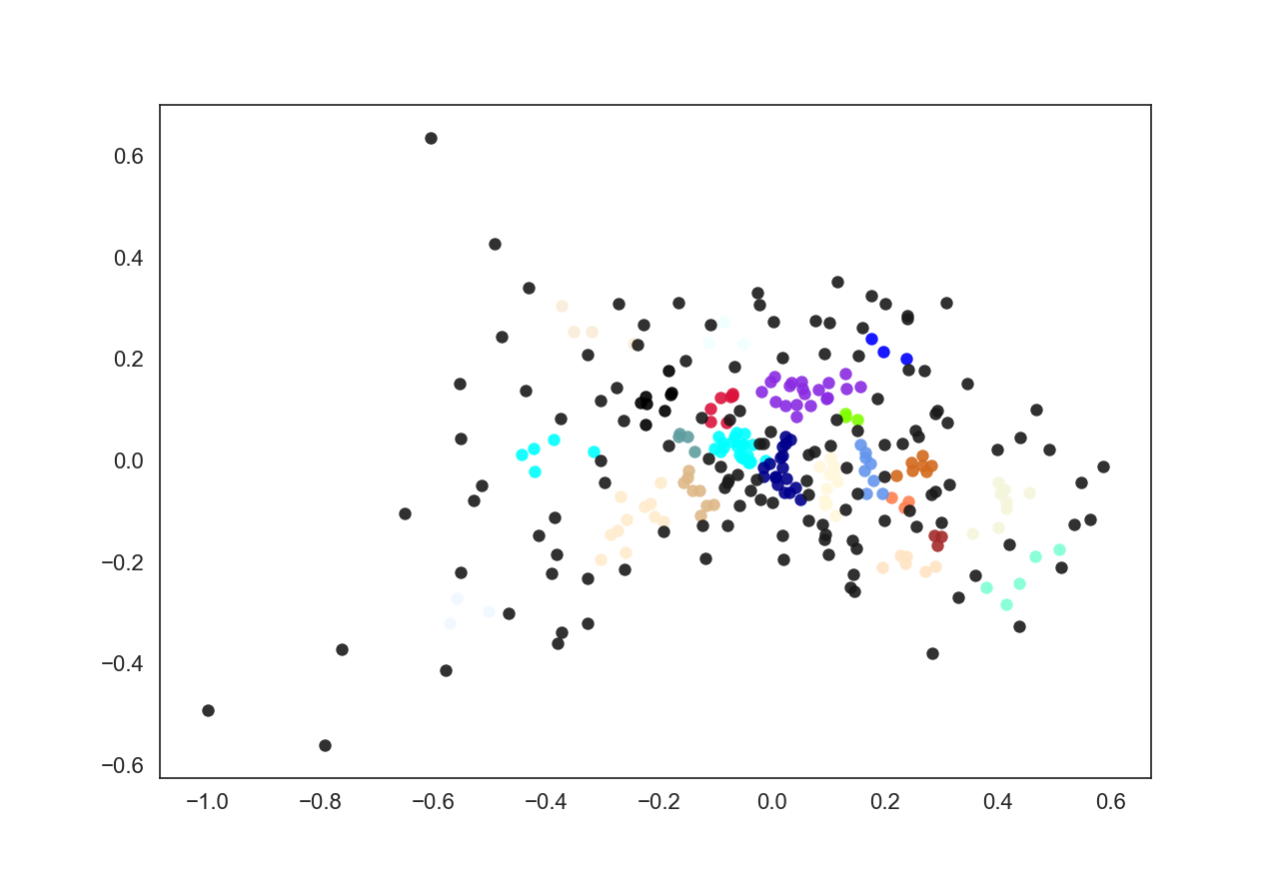
Results
Figure 2. Undirected and weighted network from year 2013 data after HDBSCAN clustering. Nodes in the same color belong to the same community.

Slide 8
Results
Station | 91 | 75 | 174 | 48 | 192 | 36 | 77 | 51 | 49 | 81
Correct | 4 | 6 | 8 | 13 | 9 | 10 | 7 | 4 | 7 | 9
Incorrect | 11 | 9 | 7 | 2 | 6 | 5 | 8 | 11 | 8 | 6
Table 1. Accuracy for morning data, in degree centrality. The overall accuracy is 51.3%.
Station | 91 | 75 | 174 | 48 | 192 | 36 | 77 | 51 | 49 | 81
Correct | 15 | 2 | 13 | 5 | 14 | 8 | 6 | 5 | 14 | 7
Incorrect | 0 | 13 | 2 | 10 | 1 | 7 | 9 | 10 | 1 | 8
Table 2. Accuracy for morning data, out degree centrality. The overall accuracy is 59.3%.

Slide 9
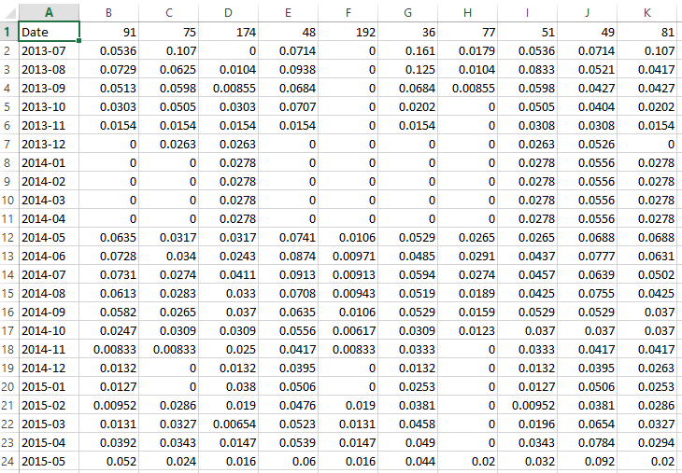
Discussion
Part 1 is good
Why part 2 failed?
Weather.
Number of rides vary from month to month.
Limited data. Only four years.
Poor feature selected.
The network is expanding rapidly.
Q-learning is not the option.
No real action.
Hard to design reward.
No convergence for dyna-Q.
Table 3. In degree centrality for morning rides.

Slide 10
Discussion and future work
How to improve?
Better network model
Dynamic target
More characteristic feature
Other machine learning algorithms
Neural network
Decision tree
Linear regression

